Slide 1
Protecting the kernel on AGL
Preventing attacks with eBPF filters

Slide 2
Agenda
Whoami
Challenge
Challenge Scope
Generic system
Challenge Scope: Narrowing
Solution
Syscall metrics and composition
Seccomp-bpf in action
Performance
Summary

Slide 3

$whoami
Location: Tokyo, Japan, previously Seattle, Washington
Role: Product Security Engineer at Woven by Toyota
Responsibilities: Security Architecture and Strategy for in production and upcoming Toyota vehicles
Hobbies: hiking, camping, babysitting my two dogs, coding
LinkedIn: https://www.linkedin.com/in/calebmcgary/

Slide 4
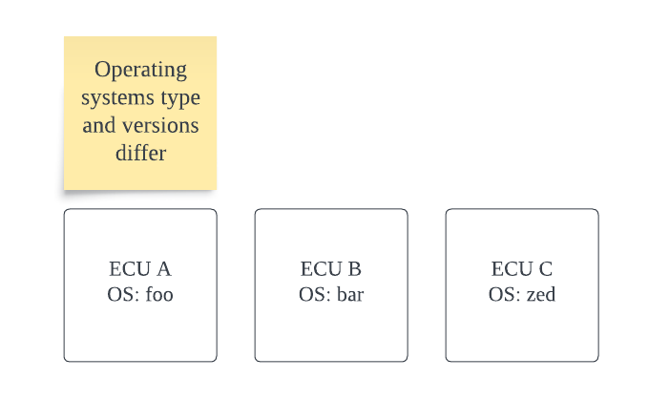
Challenge
Modern vehicles are highly interconnected software systems
These software systems must be supported for a long period of time
15+ years in many cases
Most open source software or commercial software does not have support contracts for 15+ years
Upgrades require additional care and cost due to technical constraints
There are multiple ways to address these challenges.

Slide 5
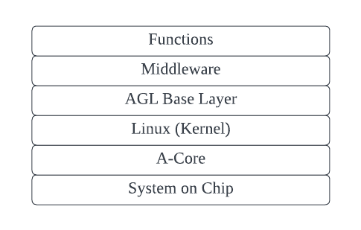
Challenge Scope
Goal:
Provide unified protection to an operating systems in event update is delayed
Requirements:
Common control across:
Linux
Android
Etc
Performant (this is important)
Must not scale o^n (exponentially)
Sample Stack:

Slide 6
Generic system: specific threat to address
1. Attacker compromises entry point. 2. Attacker attempts to spawn own process to persist in memory. 3. Attacker attempts to add new service to systemd to persist at launch.
4. Using stable persistence, attacker attempts kernel privilege escalation prior to virtual machine escape.
5. Attacker attempts virtual machine escape.
In-car Network Service Provider
In-car Communication endpoint
EL0
SEL0
Safety Function Applications
IC*/IVI HMI Applications
Service Applications
Out-car communication
Trustlets
HMI Framework
Interface
Interface
Global Platform API
EL1
SEL1
Safety API
Arene API
Middleware
Arene API
1
2
Middleware
Middleware
Middleware
Middleware
Middleware
Navi
Audio
Function Foo
Data Collector
Function Bar
IDS
TLS
Safety Services
IC/IVI SDK
Communication stack
Function zed
Function bar
Rea; time functions
Function foo
Exploit
Middleware
Middleware
3
Process separation
AGL Base System
Kernel
Kernel
Kernel
Exploit
Kernel
OS
OS
Kernel
Kernel
Linux
Kernel Module
Kernel Module
4
RTOS
Linux
Firewall
Secure OS
Firewall
Firewall
Exploit
Initialization
EL2
5
Hypervisor
TZ Driver
Application CPU Drivers
Application CPU Drivers
HAL Interface
Application CPU Drivers
MCU Drivers
RT Drivers
Hardware Interface
Com Interface
HAL Interface
TZ Drivers
SEL3
Monitoring
RT CPU
ROM
Application CPU
Application CPU
MCU
Application CPU
Shared Memory
Shared Memory
Shared Memory
Shared Memory
Ethernet
Ethernet
Ethernet
Ethernet
PCIe
PCIe
PCIe
PCIe

Slide 7
Challenge Scope: Narrowing
The upper levels of the stack often change frequently; rapid changes make having static defenses challenging.
Kernel changes less frequently than other areas of the stack.
Solution:
eBPF filtering via seccomp
Rapid evolution
Some change; more stable
Hardware; no change

Slide 8
Quick level set on what seccomp-bpf is
Seccomp filtering provides a means for a process to specify a filter for incoming system calls.
The filter is expressed as a Berkeley Packet Filter (BPF) program, as with socket filters, except that the data operated on is related to the system call being made:
system call number
system call arguments
Other metadata
Features:
Filters may be layered (has performance impacts)
Possible to apply filters to child processes
Limitations:
(BPF Filter) may not dereference pointers; constrains what can be evaluated
Notes:
https://www.kernel.org/doc/html/v5.1/userspace-api/seccomp_filter.html
eBPF Threat Model: https://github.com/ebpffoundation/publications/blob/main/2024/ControlPlane_eBPF_Security_Threat_Model.pdf

Slide 9
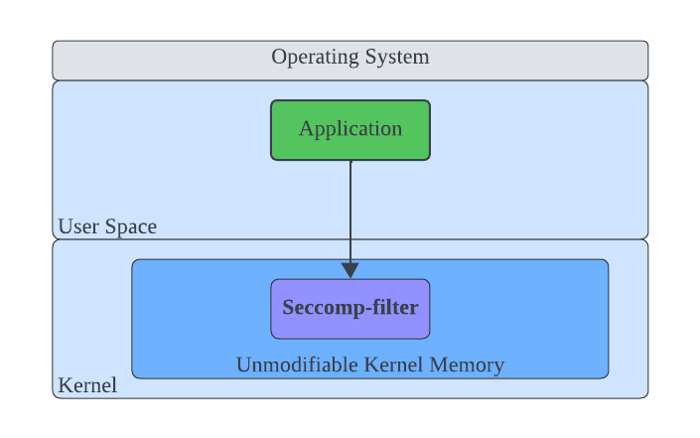
Solution
Using eBFP filters via systemd
Why systemd:
Allows us to manage services via standard Linux controls
Prevents modification of system call arguments
Acceptable performance impacts

Slide 10
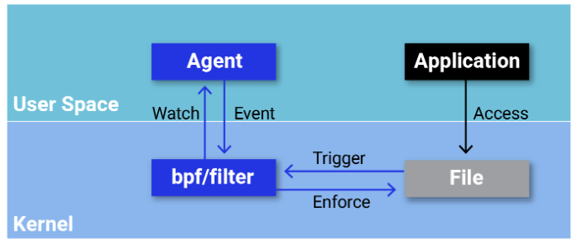
Solution: More Details
eBPF executes filter logic directly within the kernel
This means that attackers cannot manipulate system state between security check and system call execution
This is required to prevent time of check, time of use vulnerabilities (TOCTOU)
Decision:
Use seccomp-bpf with systemd to filter syscalls to protect Linux kernel
Reference: https://dzone.com/articles/seccomp-ebpf-and-the-importance-of-kernel-system-c
Notes:
https://dzone.com/articles/seccomp-ebpf-and-the-importance-of-kernel-system-c

Slide 11
Syscall metrics and composition
Obsolete syscalls
Privileged syscalls
All syscalls
All other syscalls
Syscalls that are no longer maintained but present for backwards compatibility; not part of docker allow list
Syscalls that require privilege to use; generally restricted from all unprivileged functions
Basically everything else that runs or is available in the linux kernel.

Slide 12
Seccomp-bpf in action
function
Seccomp will check to see if syscall is permitted.
If it is not permitted, return error (EPERM)
attempts
to call
syscall
middleware
kernel
Kernel remains secure from exploits via vulnerable syscalls
syslog
On denial error is logged to syslog
Function continues executing (unless seccomp is configured to kill process)

Slide 13
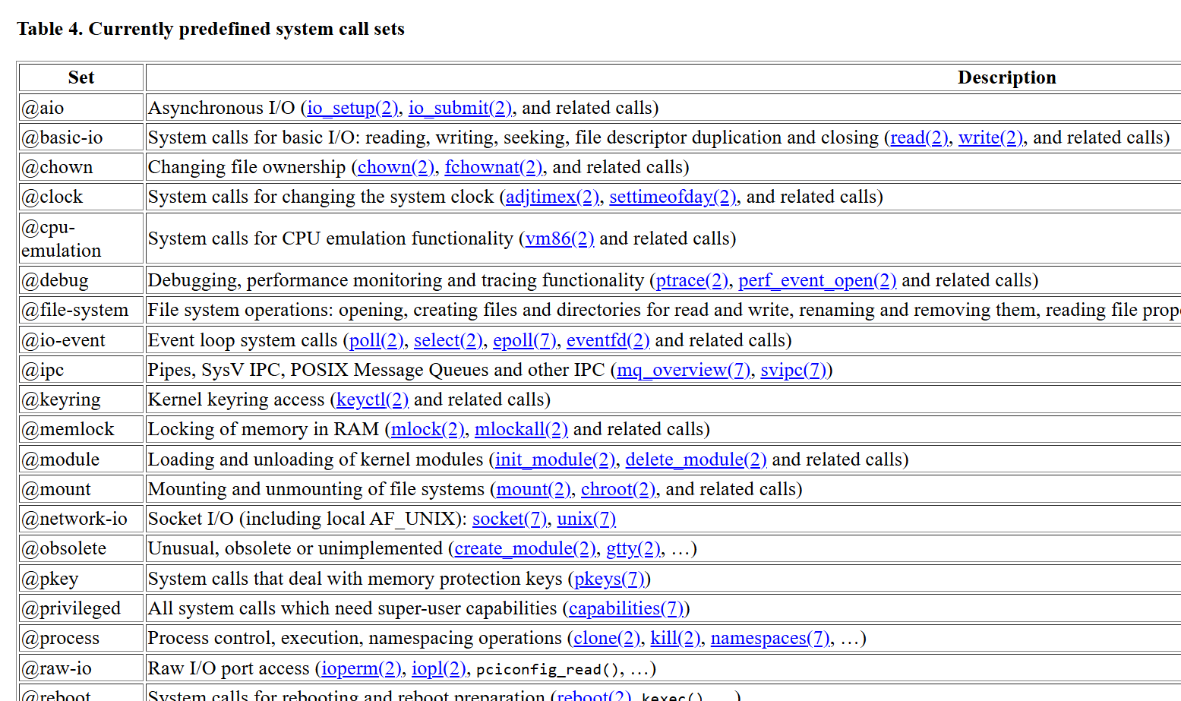
Solution
Syscall filters implemented in systemd unit files
Systemd provides syscall sets
You specify sets permitted (or not permitted)
Systemd builds an eBPF filter which is then applied to launched service
Source: https://www.freedesktop.org/software/systemd/man/latest/systemd.exec.html

Slide 14
Performance
Tested with application with single syscall and application with many syscalls;
Checked CPU, Memory and startup time
Systemd version 250
Linux 6.1
Systemd architecture:
Call execv to start process
Generate bpf filter
About 15 milliseconds (static penalty)
Read syscall configuration
Receive command to launch process

Slide 15
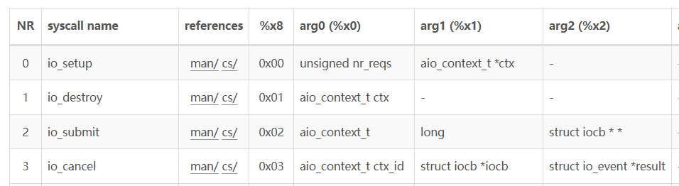
Syscall Filter List Generation
Systemd maintains a list of syscalls per architecture that it recognizes.
Systemd iterates through all syscalls (excluding ones marked as obsolete) to generate seccomp filter.
ARM64 has 267 syscalls implemented in Linux 6.1.
x86
ARM
Syscall list
Etc
If filtered; add to bpf
Syscall list
Syscall list
Arm64 syscall sample
Reference: https://blog.xhyeax.com/2022/04/28/arm64-syscall-table/

Slide 16
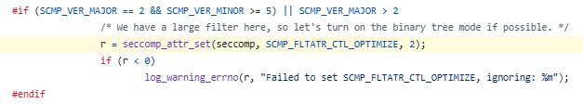
Syscall Filter List Generation
Modern versions (255+) optimize the filter.
This uses a binary tree; which further reduces any performance impact.
This binary evaluation reduces already minimal execution time penalty
Does appear to not shorten filter generation time
Reference: https://github.com/systemd/systemd/blob/80ea2271913fdbe48b413759a46b4479b07579e1/src/shared/seccomp-util.c#L1153

Slide 17
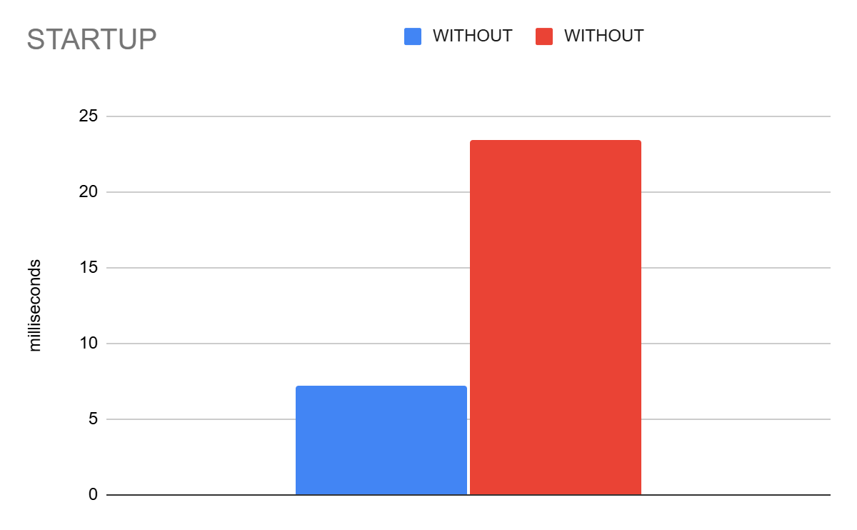
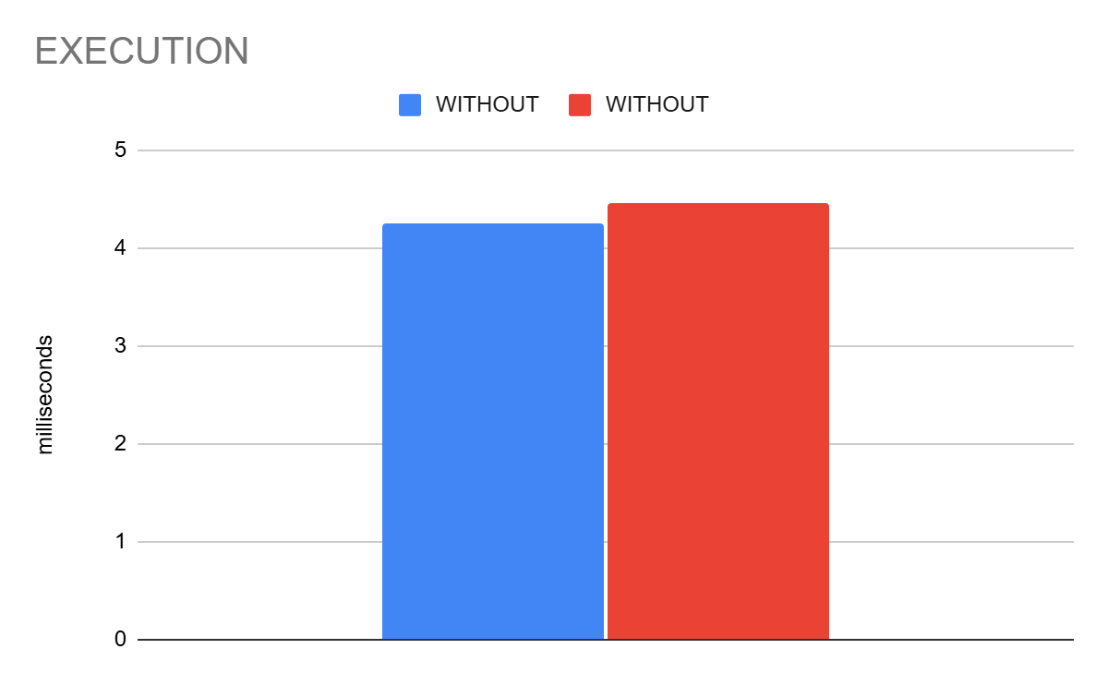
Performance: Graphs
Flat cost paid at launch for filter initialization
Due to systemd cycling through all syscalls
Negligible cost in execution
No penalty to memory was observed

Slide 18

Performance: Summary
Flat cost for filter initialization
Adds around 15-20 milliseconds to launch
Appears to be due to how the filter is constructed
Only minor penalty for execution!
This is acceptable for most scenarios!

Slide 19
Summary
Feasible to implement eBPF syscall filters with systemd with minimal performance impact
Provides substantial security protection against time of check / time of use attacks
Provides protection against attacks against the kernel by removing vulnerable or obsolete syscalls.
Thank you!

Slide 20
Questions?

